Slide 1
Blockchain Technology
DEPARTMENT OF CSE
R V College of Engineering

Slide 2
Blockchain Technology Stack
Core infrastructure layer: This layer consists of general protocols like TCP/IP (Transmission Control Protocol / Internet Protocol) that helps establish the communication between computers and the network architecture.
Middleware layer: Middleware refers to a set of tools, dev-tech, and services that make application development faster and easier
Application layer: Built on top of core infrastructure and middleware live applications.

Slide 3
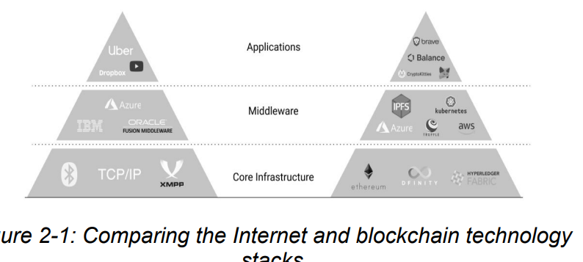
Blockchain Technology Stack

Slide 4
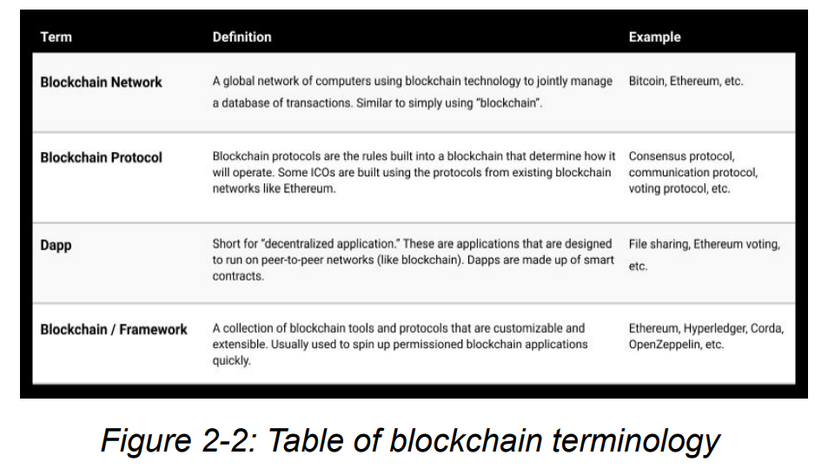

Slide 5
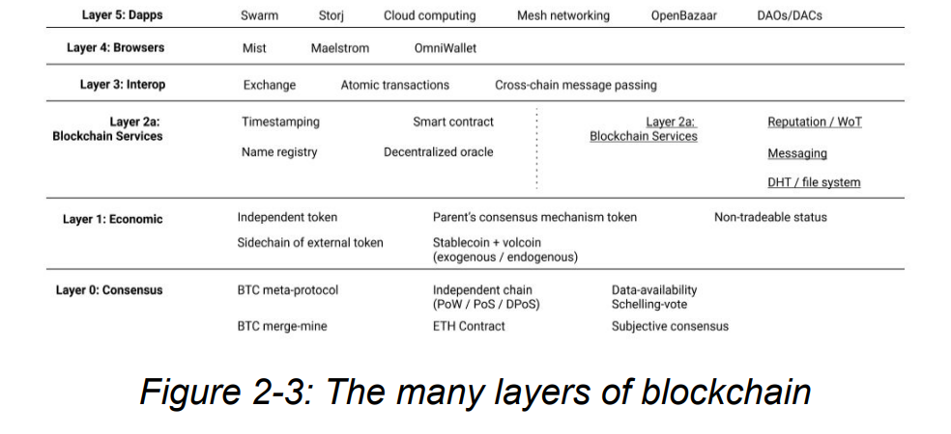
Layers of Blockchain

Slide 6
Monetizing The Blockchain
Monetizing the Core Infrastructure
Monetizing Middleware
Monetizing the Decentralized Economy

Slide 7
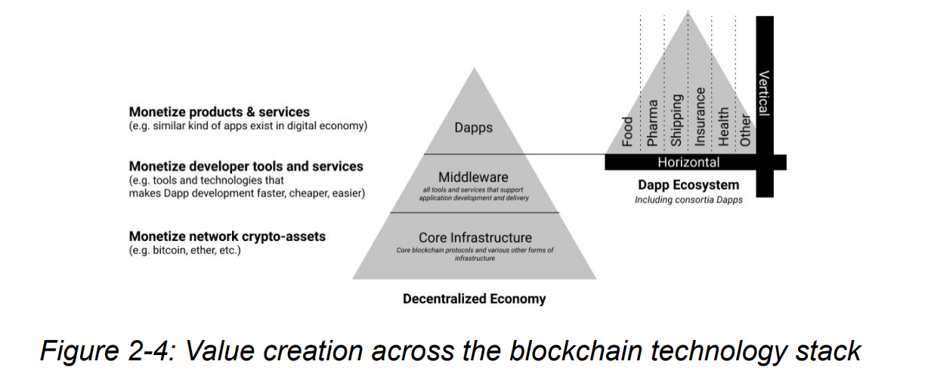
Monetizing the Blockchain

Slide 8
Monetizing the Core Infrastructure
A digital token simply represents value on a blockchain network
Bitcoin and ether can be considered examples of “intrinsic” or “native” digital tokens since each is built into its network. These tokens only exist as entries in a blockchain ledger and must be reached with a user’s private key in order to receive any value for them
The ability to create value at the network core infrastructure through tokens is one of the reasons many groups have launched new blockchains with their own digital tokens.
The main monetization opportunity at the network core infrastructure layer is tied to the idea that greater usage of a given blockchain (e.g. more transaction volume, more middleware and applications, etc.) will drive greater value of its token underlying token due to network effects.

Slide 9
Monetizing Middleware
The middleware layer of a blockchain technology stack is one of the areas where we are starting to see more experimentation because with the growth of middleware for any core infrastructure comes benefits, such as reduced complexity, improved efficiency, and an increase in application development.
Various middleware solutions are being built with smart contracts and are monetizable products or services.

Slide 10
Monetizing the Decentralized Economy
Decentralized applications are made up of smart contracts – essentially, software that encodes business logic or governance.
Almost any current application that exists in our digital economy can be re-imagined as a product or service in the decentralized economy built on blockchain technology.
Consumers can interact with specific Dapps that sit on top of the blockchain stack which take advantage of asset tracking, identity management, and so forth.

Slide 11
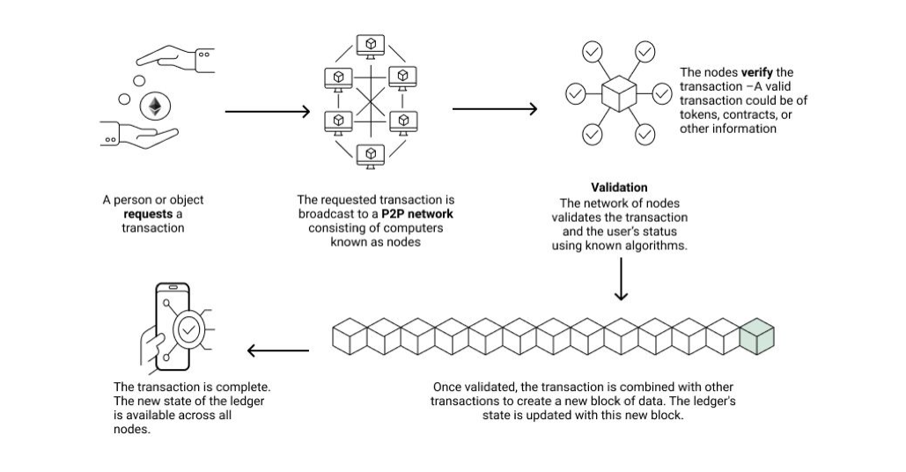

Slide 12
A case Study: Koffeecoin

Slide 13
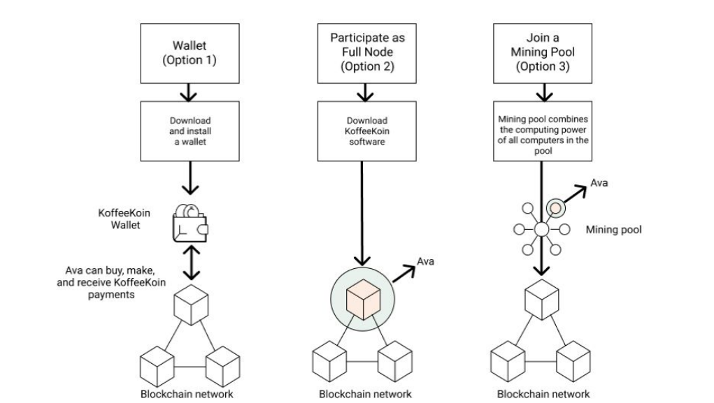
Option to participate in Koffeecoin

Slide 14
Blockchain Wallet
Blockchain wallets are essential to participation in a blockchain network. Each blockchain network has its own version of a wallet, but the “access” that a wallet provides is much broader than just a financial warehouse as with a bank account.
Virtual machine
Cold Storage
Hardware wallets

Slide 15
Consensus
When you download blockchain software and become a full node on a network, this means that you can participate in generating a consensus among all of the nodes.
In the case of Bitcoin, the consensus rules of the network determine how the participants in the network interact with each other. They define:
The conditions under which a transaction (i.e. sending tokens from party A to party B) are valid.
The transaction costs related to sending money from party A to party B.
The incentive mechanism for validating transactions with a digital token.
Rules of how to change current consensus rules.

Slide 16
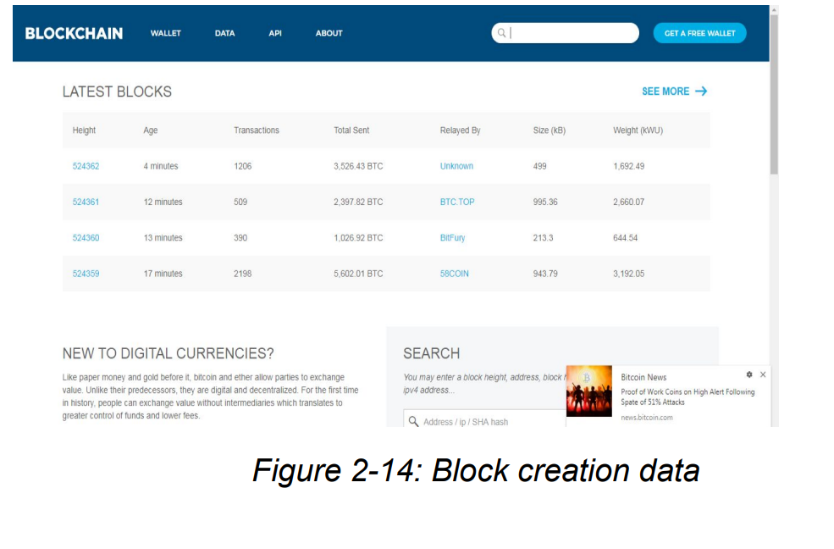
Blockchain creation Data

Slide 17
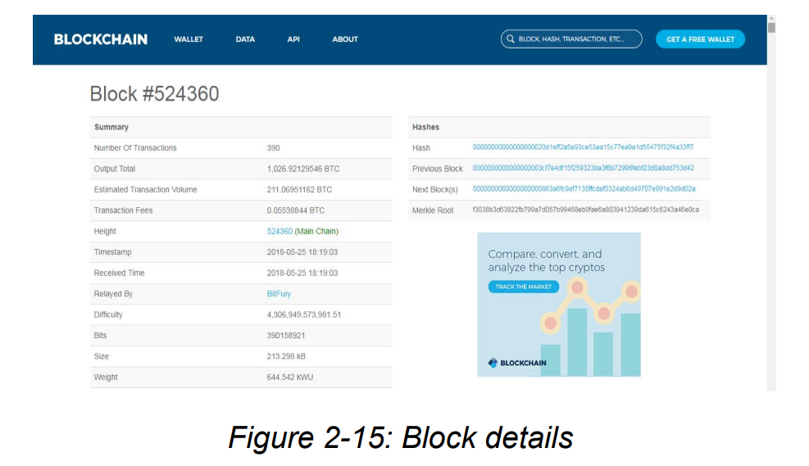
Block Deatils

Slide 18
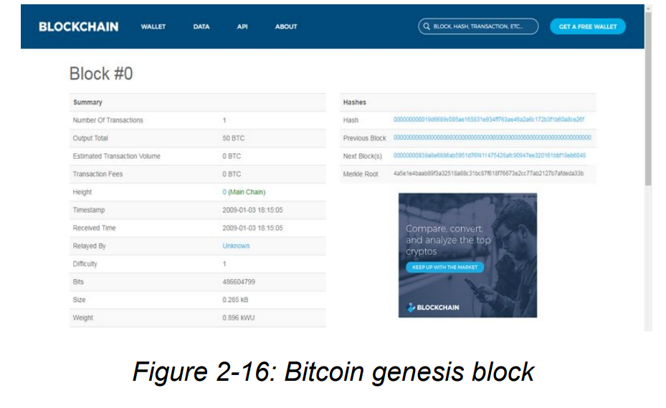
Genesis Block

Slide 19
Blockchain as a Service (BaaS)
Because of the intense hype around blockchain, many large software firms are racing to deploy a version of blockchain that would take advantage of the cloud to create “on demand” blockchain networks.
Animal Ventures is launching an open source platform called Orb Weaver, which allows users to launch a blockchain network on the cloud and provide other services to ease the development of blockchain applications.
The basic idea for all these services is that by hosting the blockchain network in the cloud, software companies can help smaller outfits get up and running on a blockchain quickly without the extreme cost of hiring hard-to-find blockchain developers.

Slide 20
Contd..
the core layer is very time intensive to develop and requires expertise in kernel development as well as many other disciplines that come together to define blockchain protocols (economics or game theory, mathematics, cryptography, and computer science, to name a few).
Rather than every company trying to prototype or build their own blockchain, BaaS begins to move the prototyping process up into higher parts of the technology stack. This means that companies, especially those whose business is not as technology-heavy, can develop use cases and prototypes for solving specific business pain points through applications of blockchain higher in the stack.

Slide 21
Contd..
The upside of spinning up a blockchain using a BaaS implementation includes lowered needs for talent in development and security at the core layer, decreased time to experimentation, and potentially greater customer support.
However, outsourcing this work has its downsides as well, including a recentralization of certain functionality, systems lock-in with the chosen provider, as well as the costs of renting the resources to run a hosted blockchain instance

Slide 22
Information Technology Use Cases for Blockchain
Storage
Edge Computing
IPFS

Slide 23
Web 3.0 and Blockchain
the Web3 Foundation advocates for a shift to a server-less Internet, or as their site describes, “An internet where users are in control of their own data, identity and destiny.
The services that are being built on top of Web 3.0 infrastructure include file distribution and storage (e.g. Storj, Siacoin, Filecoin, IPFS), decentralized versions of communication platforms like Skype (e.g. Experty.io) and WhatsApp (e.g. Status), and social networks that offer micro-transactions instead of Facebook (e.g. Steemit), as well as freelance networks that function like Upwork (e.g. Ethlance).
These services are still in their infancy but much of the excitement around blockchain technology lies in its relationship to a greater vision for a decentralized economic infrastructure to underpin our digital world.

Slide 24
Obstacles in Blockchain Technology
Sybil Attacks
Key Management
Scalability
Dispute Resolution
Updating and Governance

